Slide 1
MODULE V
DATA FLOW COMPUTERS

Slide 2
DATA-DRIVEN COMPUTING & LANGUAGES
Data flow computers are based on the concept of data-driven computation, which is drastically different from conventional von Neumann m/c
Data flow computer is driven by data(operand) availability
Data flow model offers an approach towards the design of future supercomputers by meeting the foll. Demands
high performance/cost ratio
Match the ratio with technological progress
offer better programmability in application areas

Slide 3
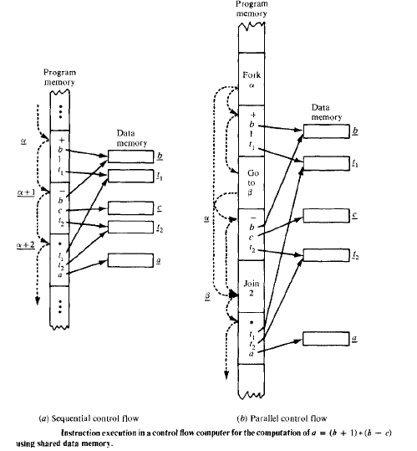
Control flow computers

Slide 4
Statement a=(b+1) * (b-c) is specified by a series of instructions with an explicit flow of control
Shared memory cells are the means by which data is passed b/w instructions
Solid arrows show access to stored data, dotted arcs indicate flow of control

Slide 5
In traditional sequential control flow (von Neumann) there’s only a single thread of control, passed from instruction to instruction
In parallel control flow, special control flow operators like FORK, JOIN are used to specify parallelism
More than one thread of control is active at a time

Slide 6
Special features identified for either sequential or parallel control flow model :-
data is passed b/w instructions via references to shared memory cells
Flow of control is implicitly sequential, but special control operators can be used for parallelism
Program counters are used to sequence the execution of instruction

Slide 7
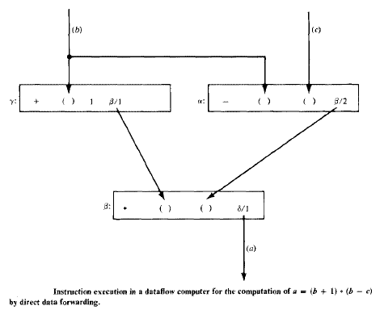
Data flow computer

Slide 8
Instructions are activated by availability of data tokens as indicated by ( )
Each instruction consists of an operator, one or 2 operands, one or more destinations to which result or data token will be sent
Features of data flow model
Intermediate or final results are passed directly as data token b/w instructions
There’s no concept of shared data storage
Program sequencing is constrained only by data dependency among instructions

Slide 9
Data driven concept means asynchrony, many instructions can be executed simultaneously & asynchronously
Information items in a data flow computer appear as operation packets & data tokens
An operation packet consists of opcode, operands, & destination of its successor instructions
Data token is formed with a result value & its destinations

Slide 10
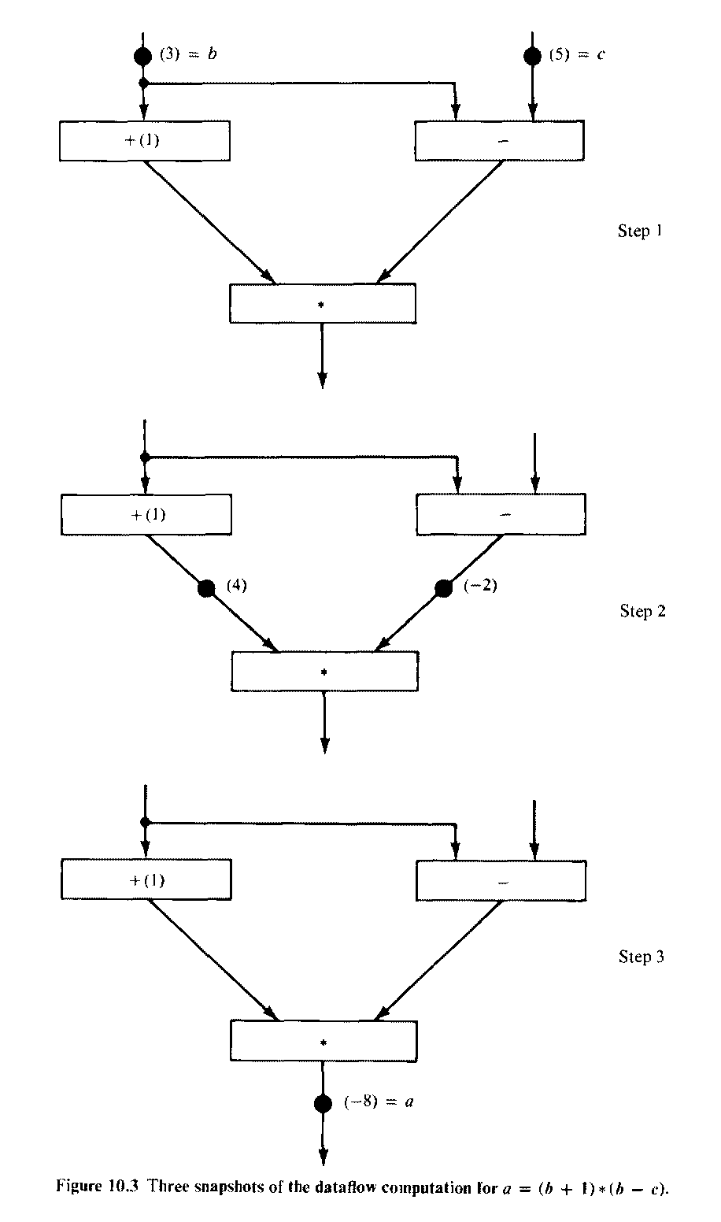

Slide 11
Data flow machine architecture
Depending on the way of handling data tokens, data flow computers are classified into
static model
dynamic model

Slide 12
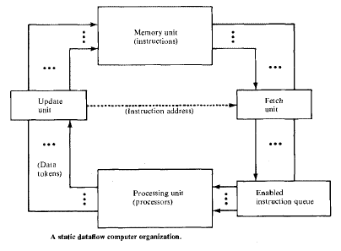
Static dataflow computer organization

Slide 13
Data tokens move along the arcs of data flow program to operator nodes
Only one token is allowed to exist on any arc at any given time
This architecture is considered static coz tokens are not labeled

Slide 14
Data tokens form the pool of update unit
Update unit passes data tokens to their destination instructions in memory unit
When an instruction receives all its required operand tokens, its enabled and forwarded to the enabled queue
Fetch unit fetches these instructions when they become enabled

Slide 15
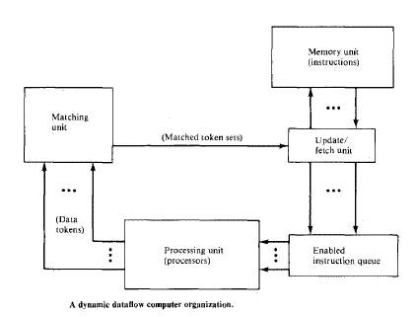
Dynamic dataflow computer organization

Slide 16
Dynamic dataflow m/c uses tagged tokens, so that more than one token can exist in an arc
The tagging is achieved by attaching a label with each token which uniquely identifies the context of that particular token
Maximum parallelism can be achieved

Slide 17
System synchronization is based on a matching mechanism
Data tokens form the input pool of matching unit
This matching unit arranges data token into pairs & temporarily stores each token until all operands are compared,
matched token sets are released to fetch-update unit

Slide 18
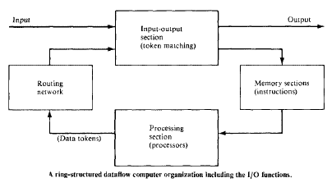
Ring structured data flow organization
Both static & dynamic data flow architectures have a pipelined ring structure
If we include the I/O, a generalized architecture is obtained

Slide 19
The ring contains 4 resource sections :-
memories, processors, routing n/w, I/O unit
Memories are used to hold the instruction packets
Processing unit helps in parallel execution of enabled instructions
Routing n/w is used to pass the result tokens to their destined instructions
I/O unit serves as an interface b/w data flow computer & outside world

Slide 20
Major design issues
The development of efficient data flow language
The data decomposition of pgms and the assignment of program modules to data flow computers
Controlling and supporting large amount of inter process communication
Developing intelligent data driven mechanisms

Slide 21
Major design issues
Efficient handling of complex data structures
Developing memory hierarchy and memory allocation schemes
A large need of user acquaintance of functional data flow languages, software support ,data flow compiling etc
Performance evaluation of data flow hardware in various applications

